Slide 1
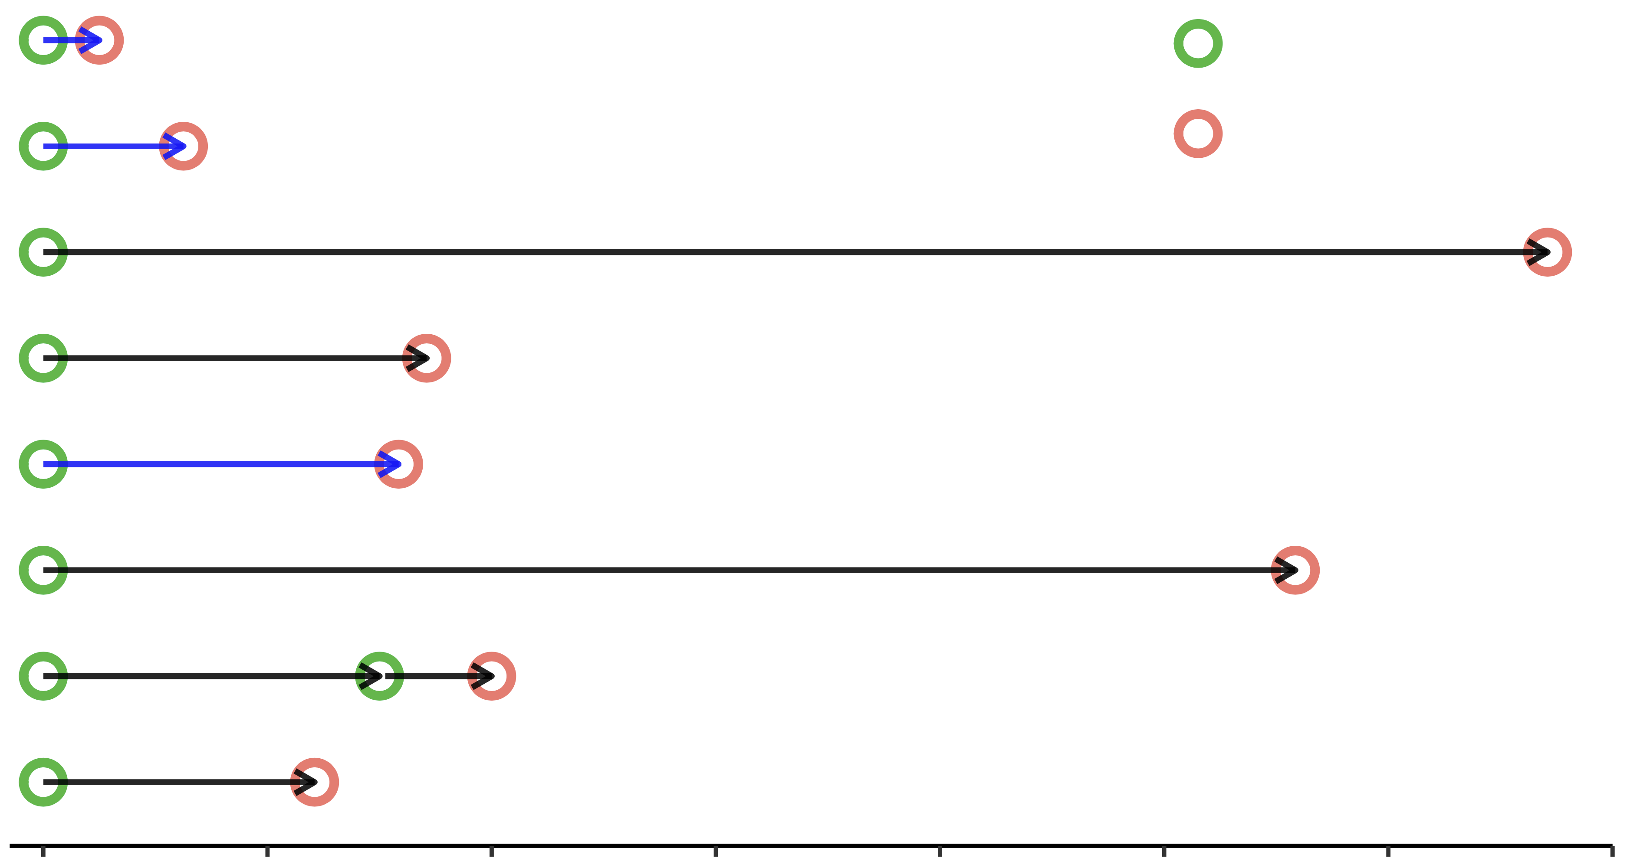




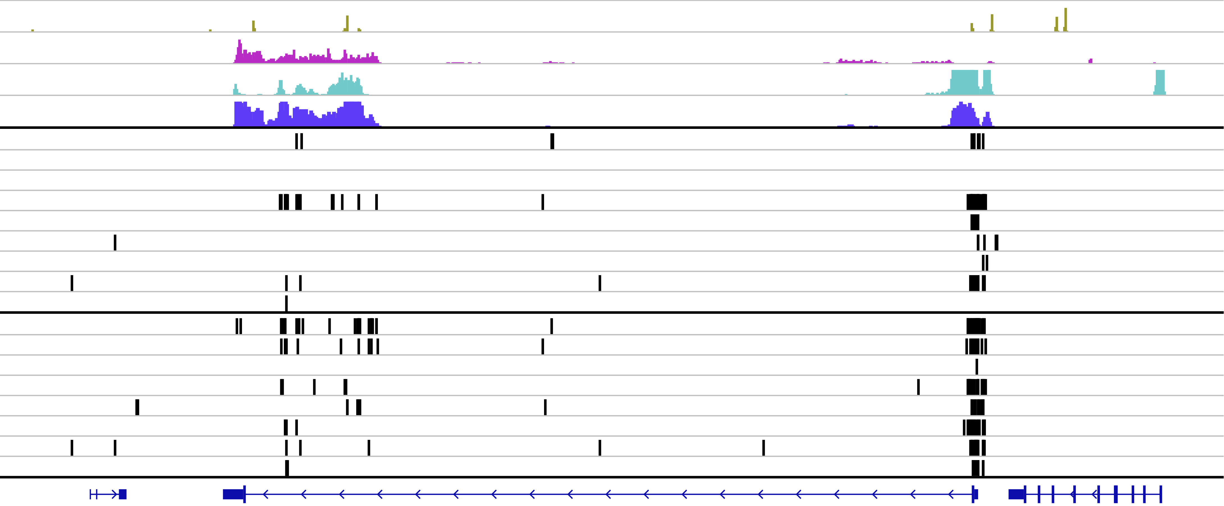
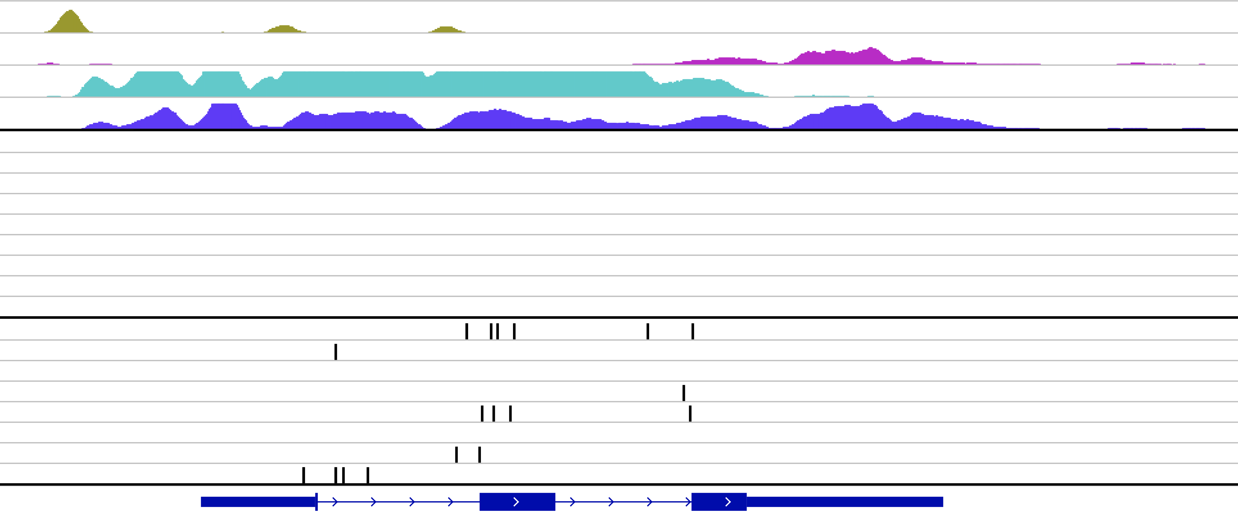
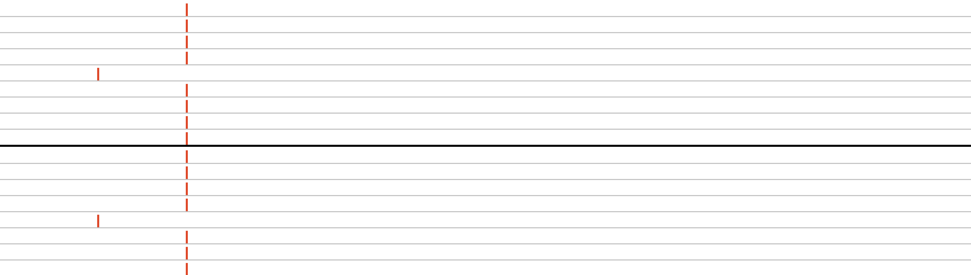
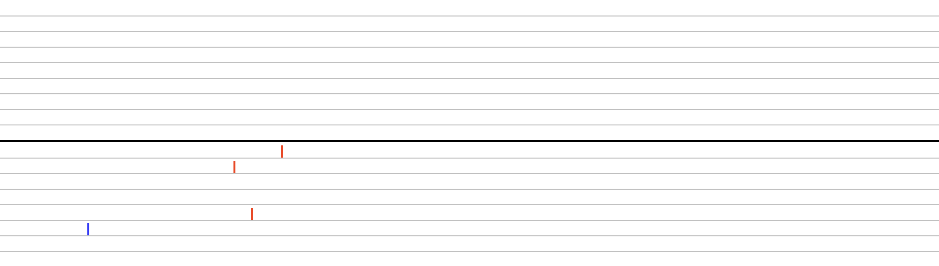
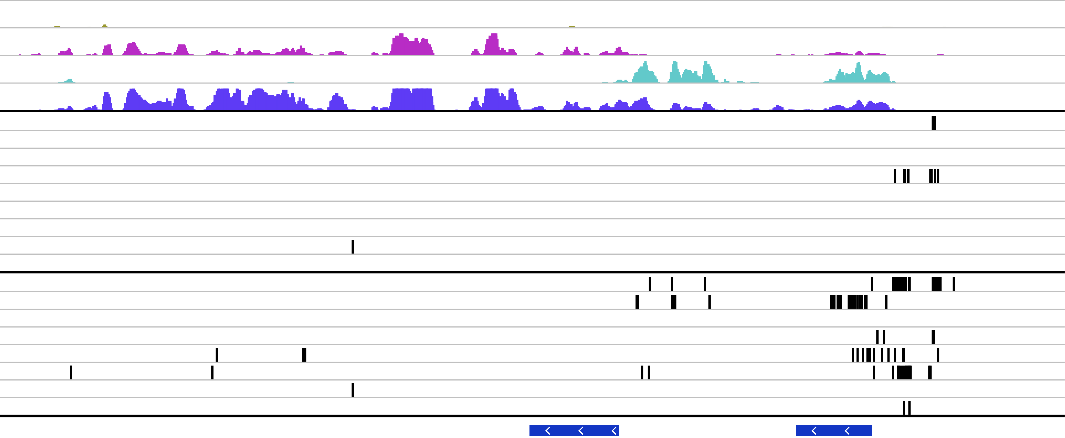
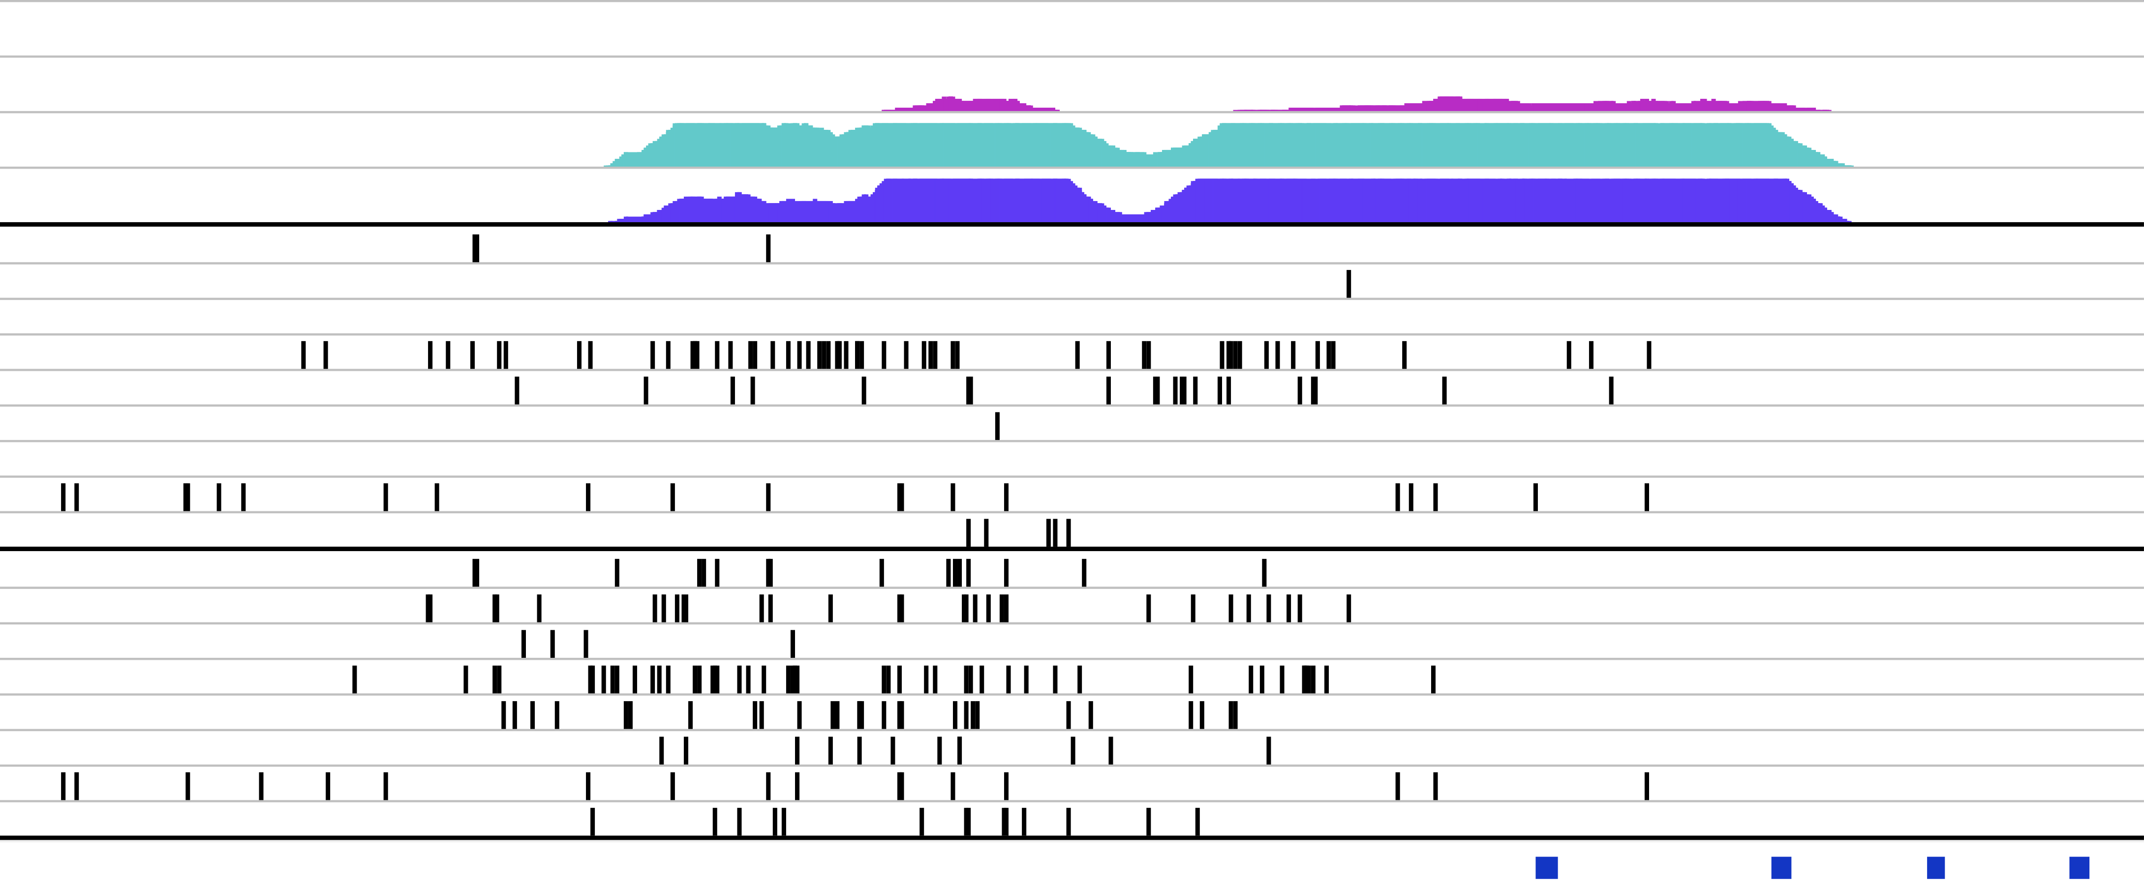
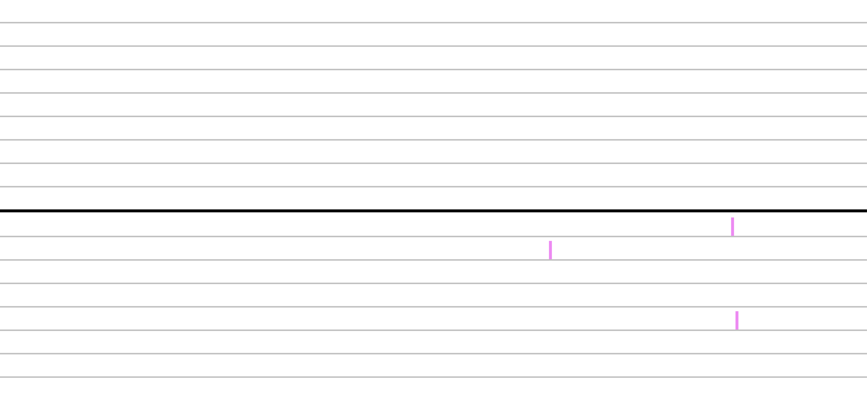
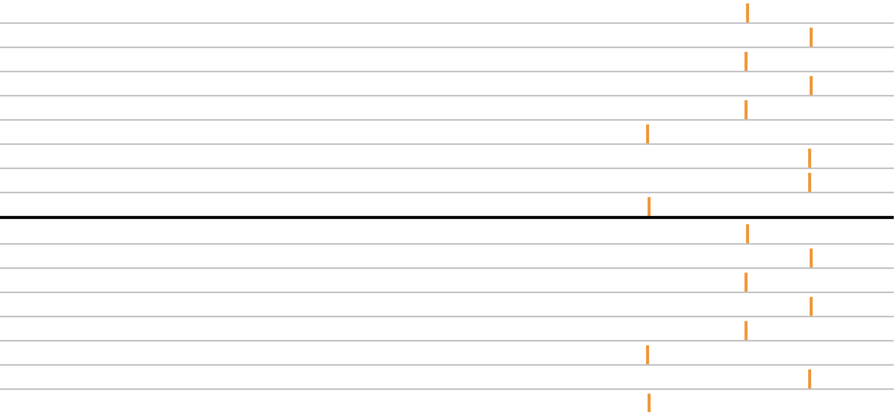
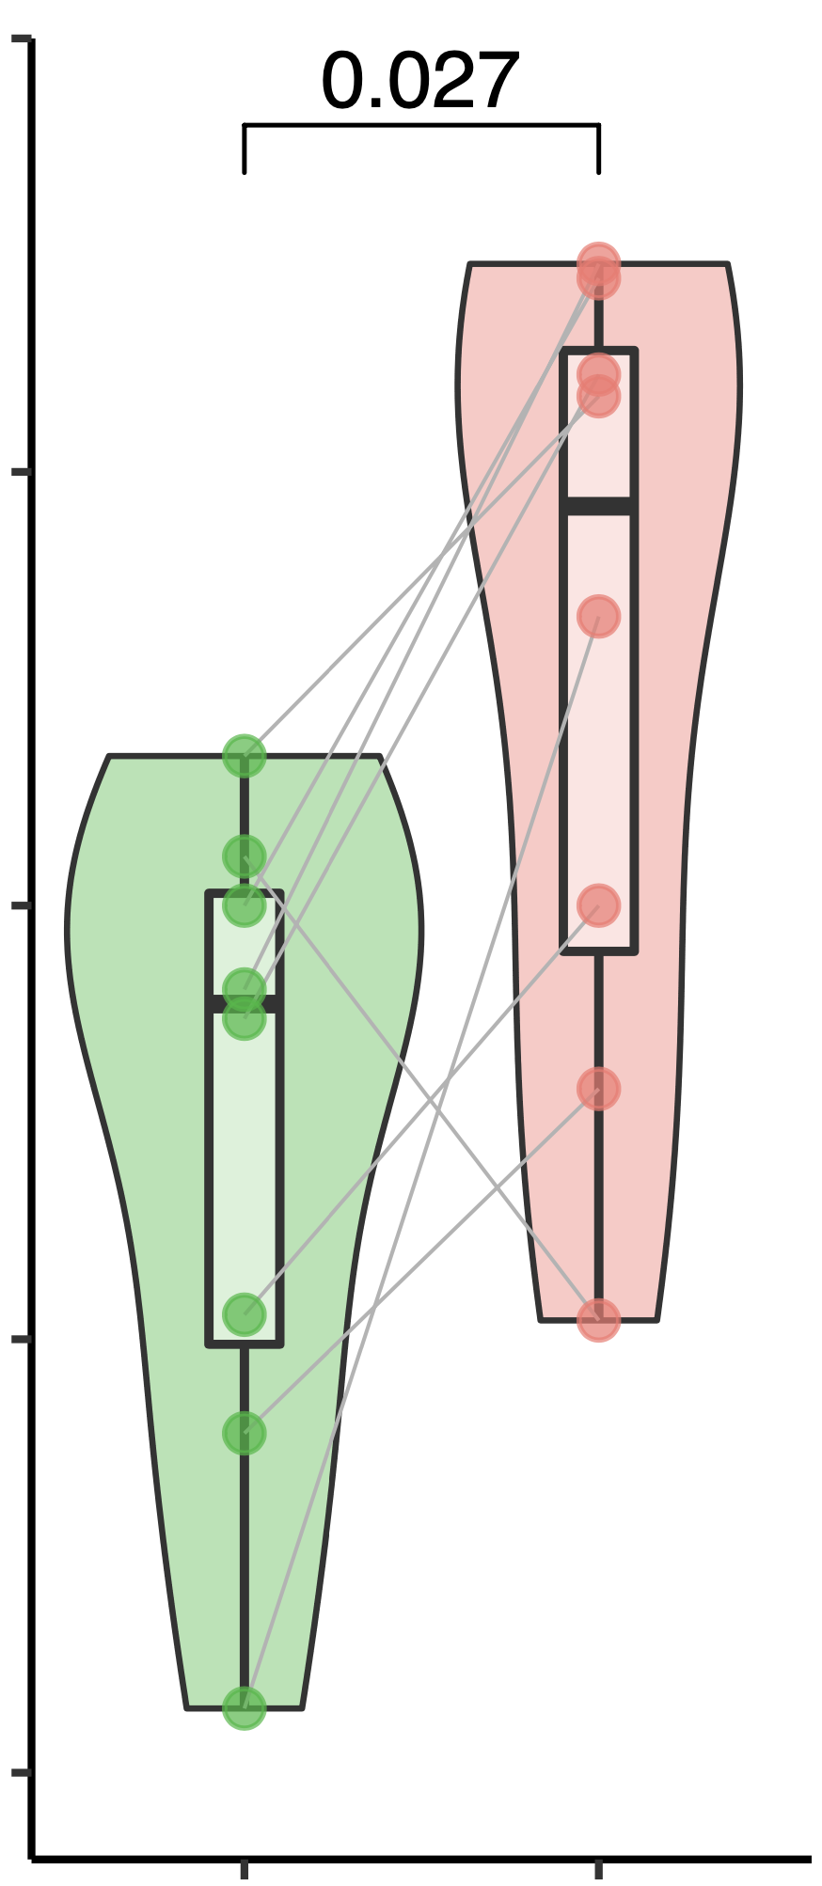
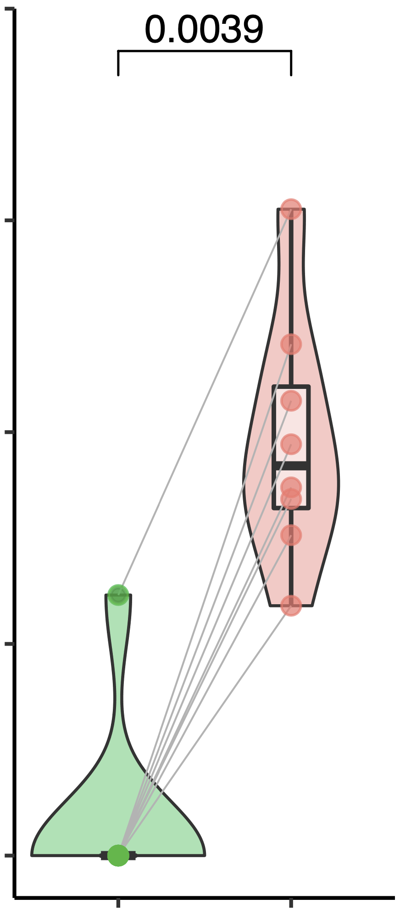
a.
b.
IgH (P6)
IgH (P7)
Both FL & DHL
IgH (P8)
IgH (P9)
IgH (P2)
IgH (P4)
IgH (P1)
P1
FL
IgH (P5)
DHL specific
P2
DHL
chr18
…
P4
63097227
63318081
P5
BCL2
P6
P7
CYRIB (P5)
IRAG2 (P4)
LPP (P7)
LPP (P9)
IgH (P2)
IgH (P6)
P8
a
b
IgH (P1)
IgL (P8)
P9
0
2
4
6
8
10
12
14
chr8
…
……
…
127728571
127769053
128086077
Time after initial diagnosis (year)
MYC
128109219
c.
CTCF
chr18:63,064,788-63,383,469
chr8:127,733,380-127,745,928
H3K4me1
[0-200]
[0-400]
H3K4me3
[0-200]
[0-400]
H3K27ac
[0-200]
[0-400]
[0-400]
P1
[0-400]
P1
P2
P2
P4
P4
P5
FL
P5
P6
P6
P7
P7
P8.a
P8.a
P8.b
P8.b
P9
P9
P1
P1
P2
P2
P4
P4
P5
P5
DHL
P6
P6
P7
P7
P8
P8
P9
P9
XR_935570.2
BCL2
KDSR
MYC
CTCF
chr14:105,555,800-105,611,800
chr14:105,859,204-105,864,775
H3K4me1
[0-200]
[0-200]
H3K4me3
[0-200]
[0-200]
H3K27ac
[0-200]
[0-200]
[0-400]
[0-400]
P1
P1
P2
P2
P4
P4
FL
P5
P5
P6
P6
P7
P7
P8.a
P8.a
P8.b
P8.b
P9
P9
P1
P1
P2
P2
P4
P4
P5
P5
DHL
P6
P6
P7
P7
P8
P8
P9
IgH (C)
A2
E
P9
IgH (J)
J5
J4
J3
Somatic mutation
J6
Translocation to IgH
Translocation to LPP
Translocation to MYC
Translocation to BCL2
d.
1
e.
p = 0.027
1
p = 0.0039
0.75
0.75
0.5
0.5
AF of BCL2 structural variation
AF of MYC structural variation
0.25
0.25
0
0
FL
DHL
FL
DHL
Figure 1
Notes:
Sliding window
Zoom in and chi test for right fig

Slide 2
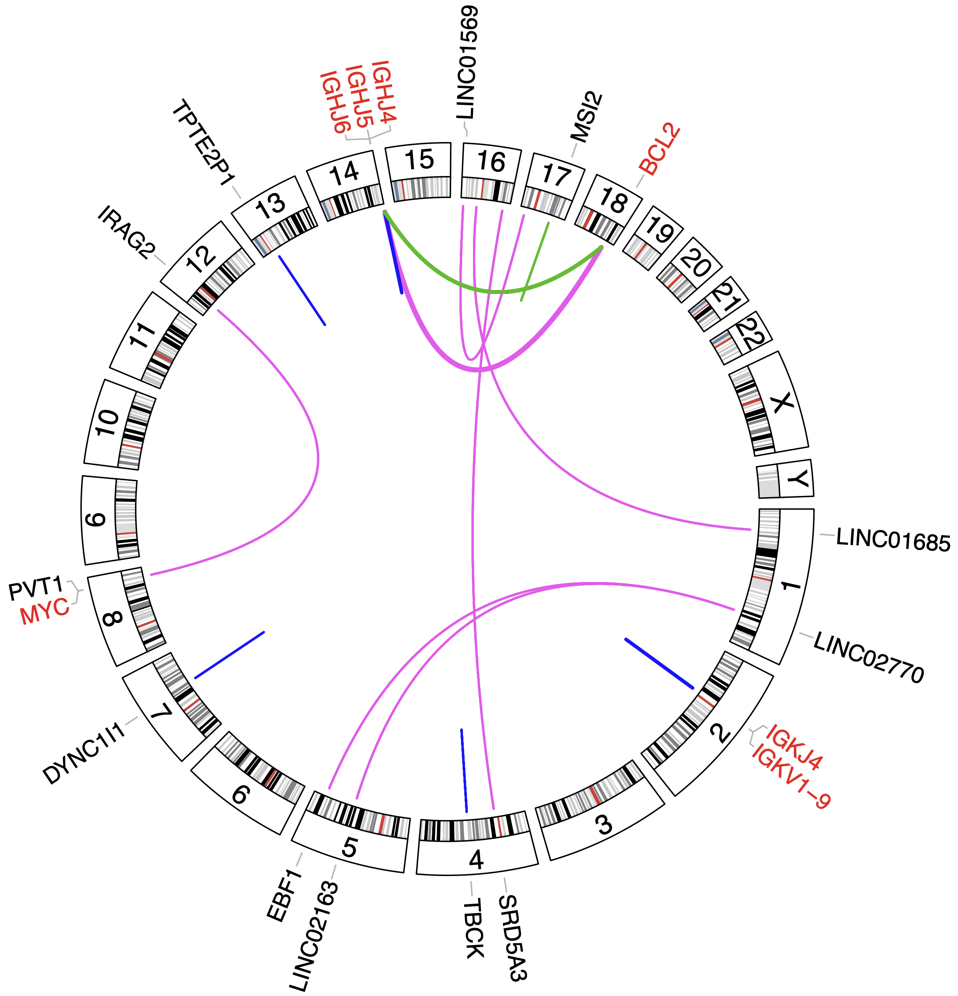
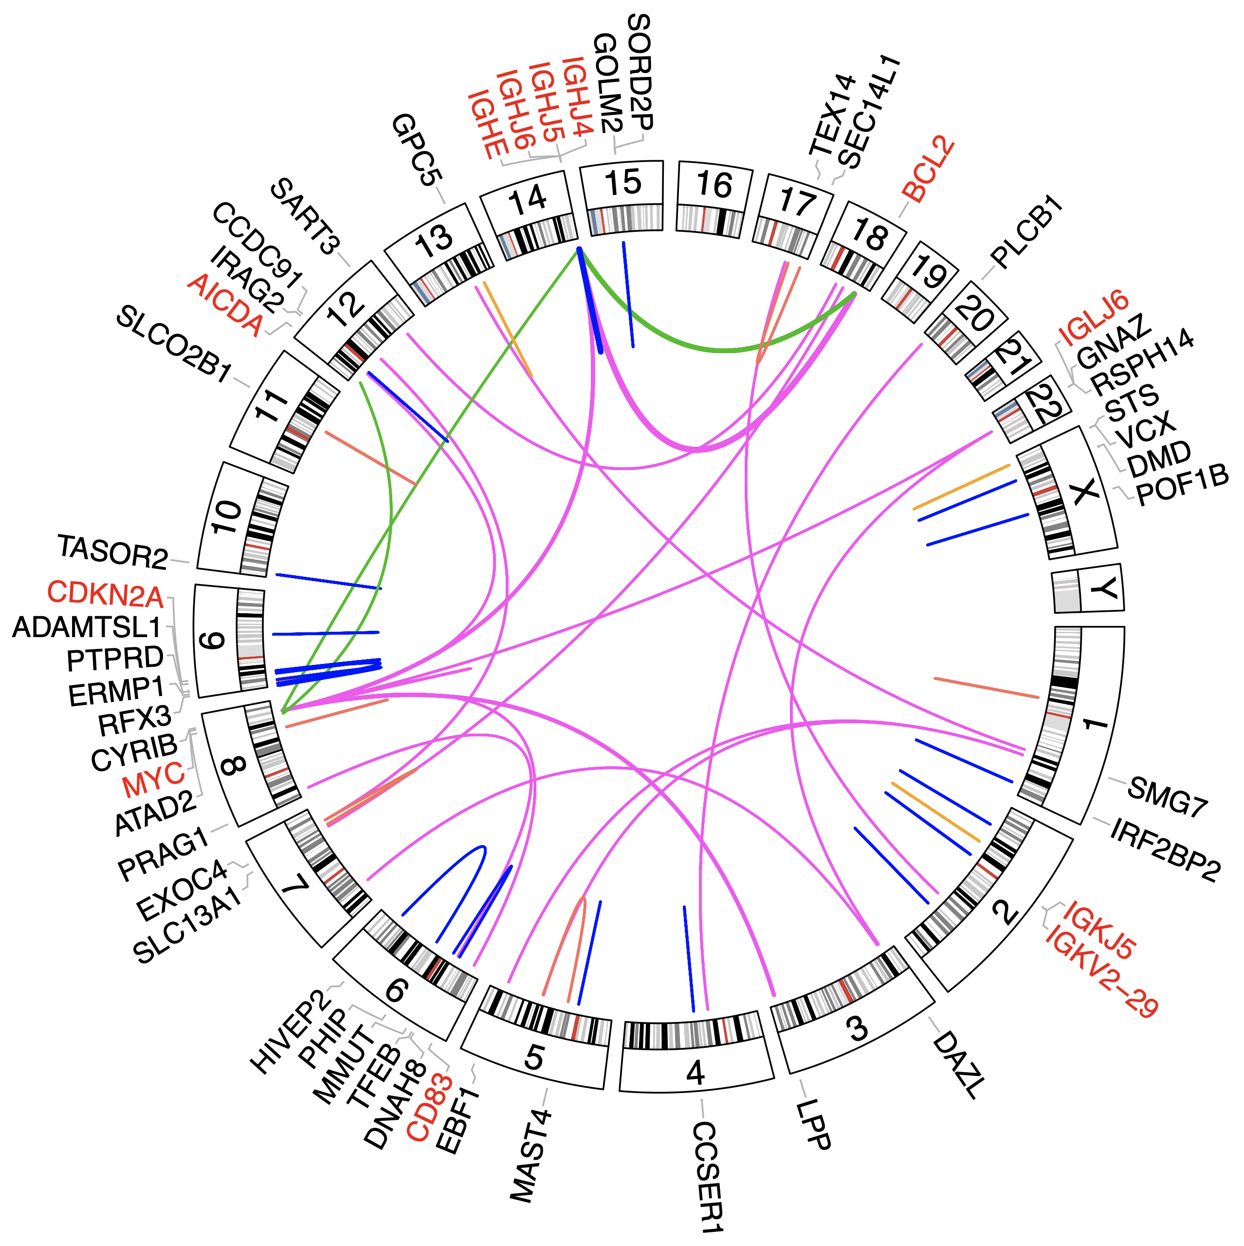
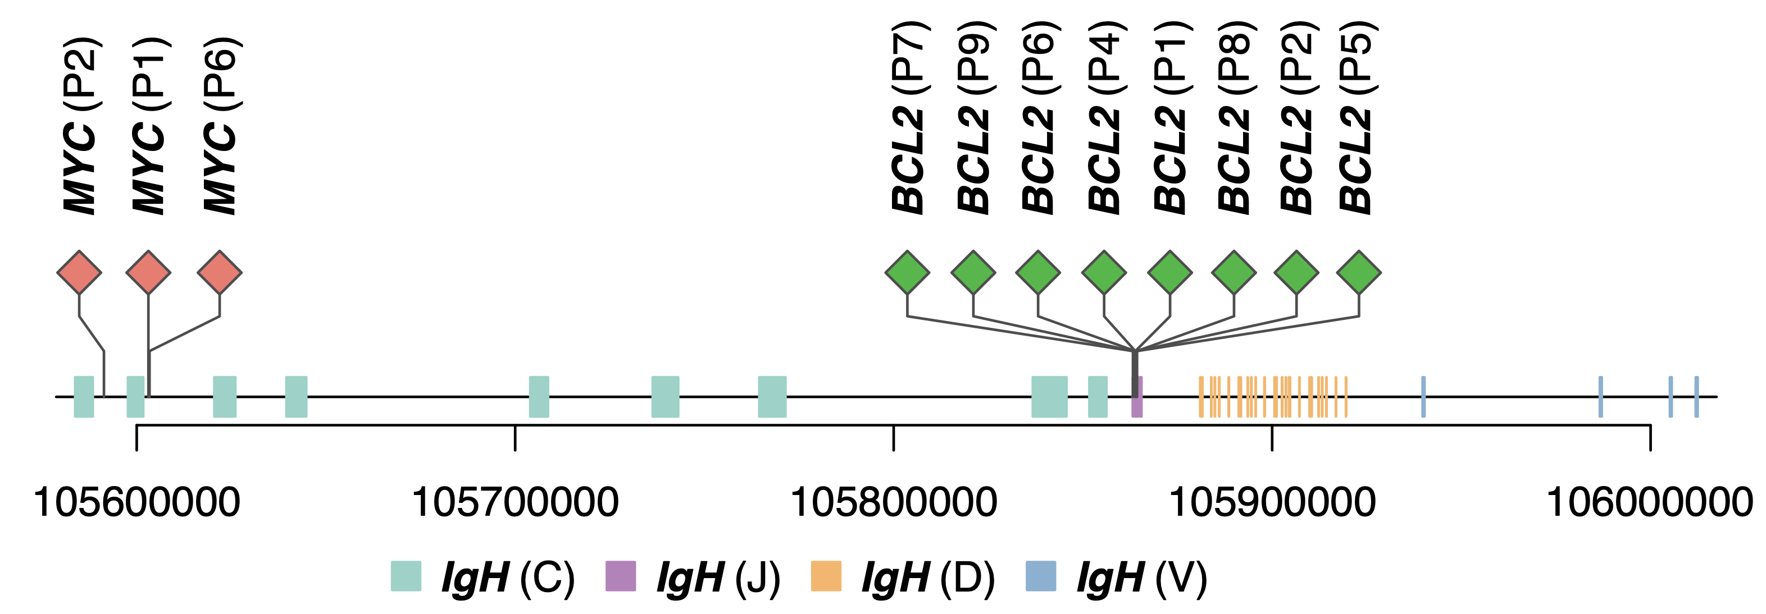
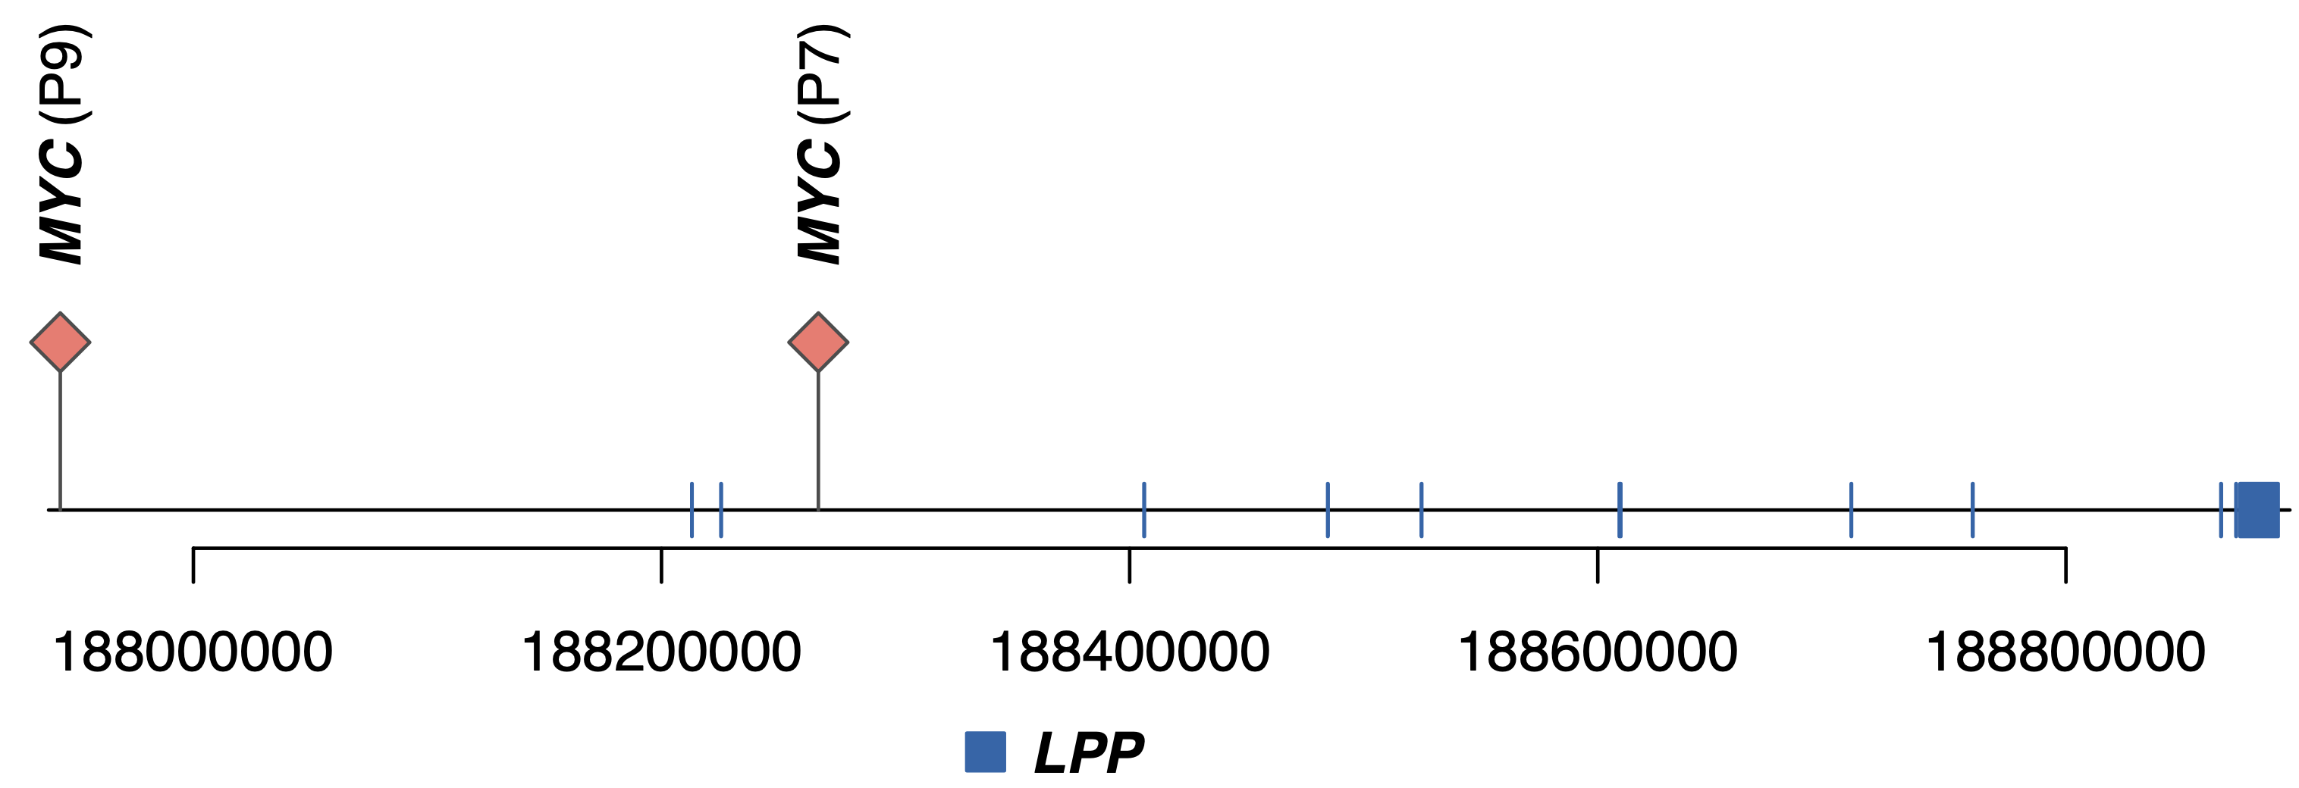

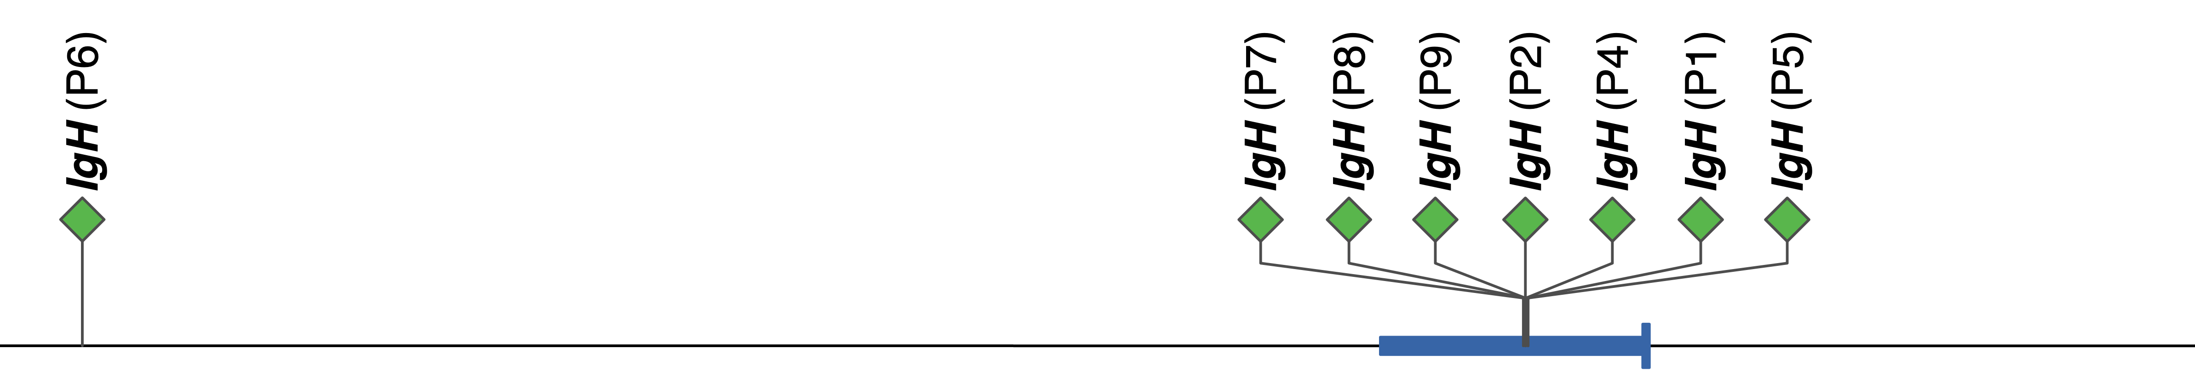


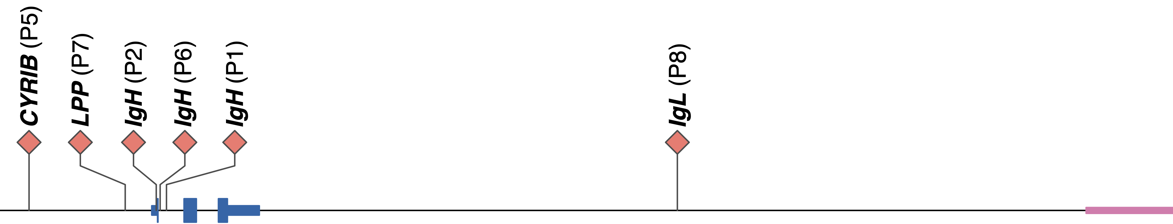
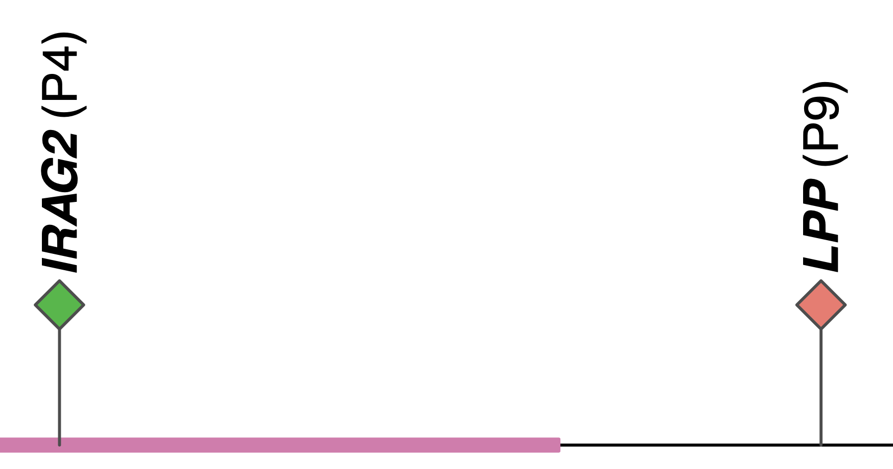

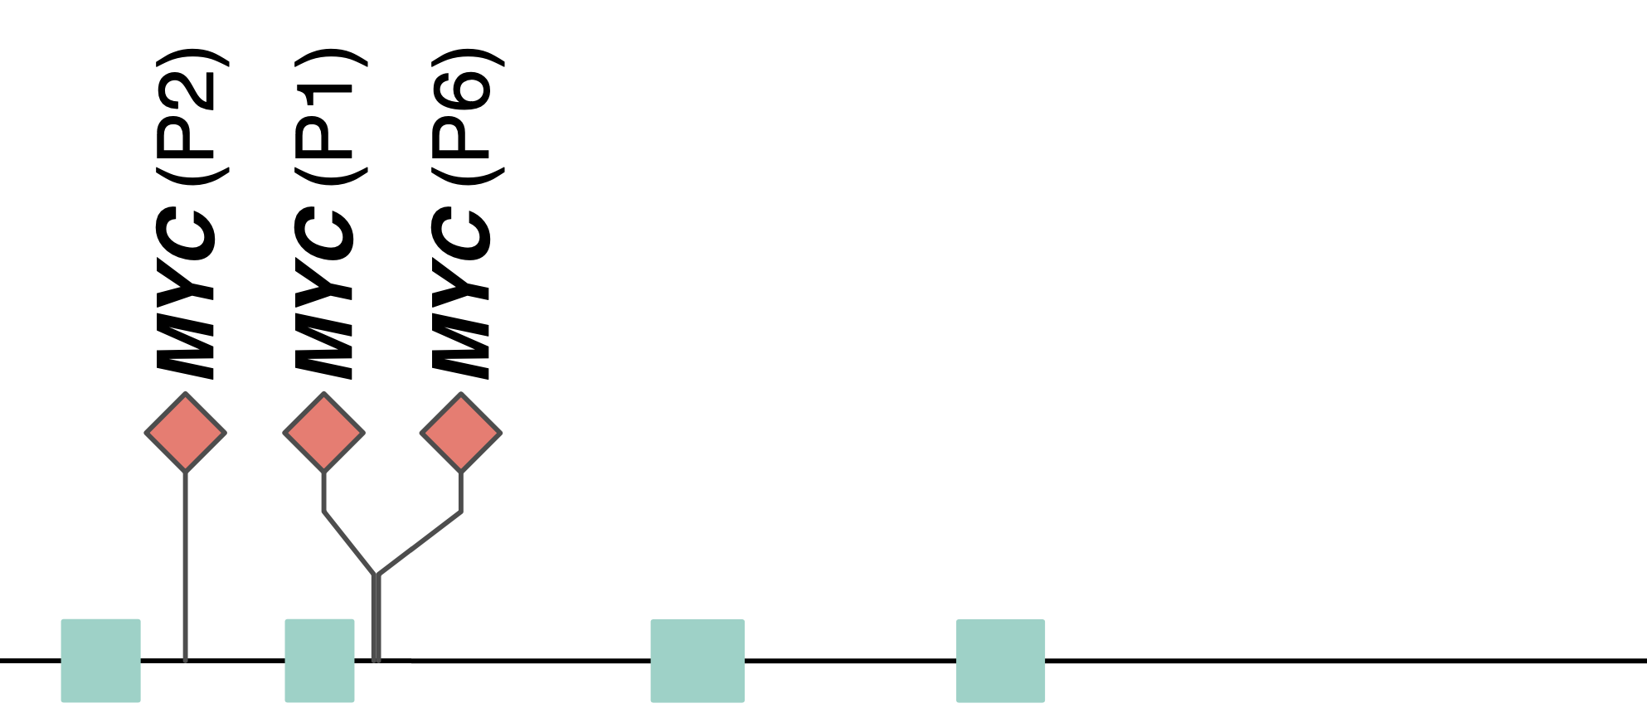
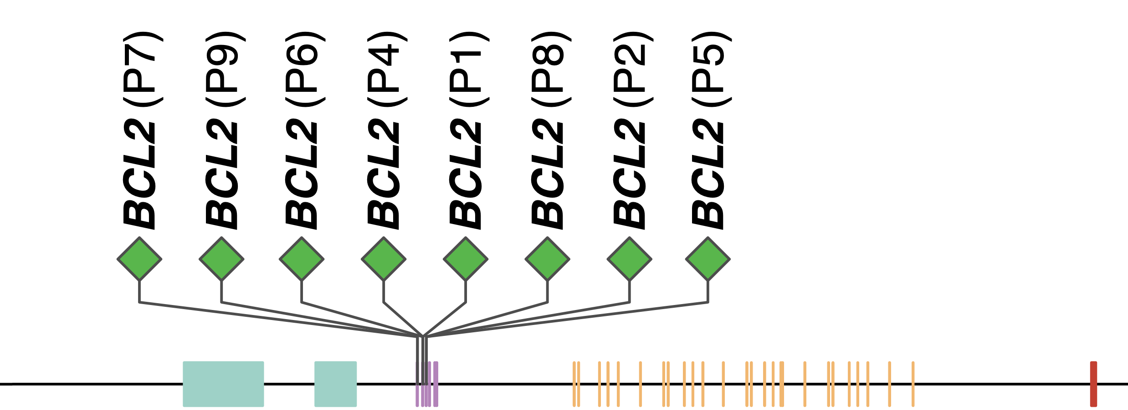
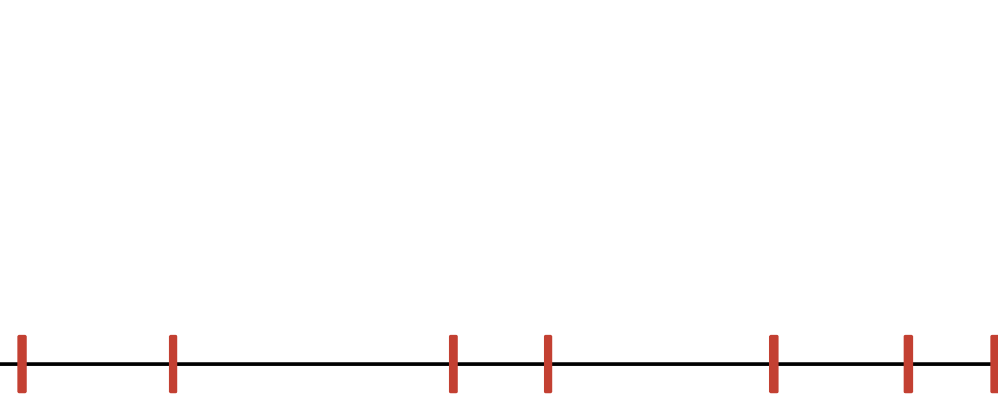

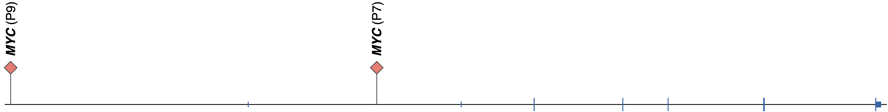

A
Interchromosomal translocation
B
Tandem duplication
Both FL & DHL
Deletion
DHL specific
Insertion
Inversion
chr14
FL tumors
DHL tumors
chr3
B
Both FL & DHL
DHL specific
chr18
63123346
63318081
63097226
C
chr8
127728567
127769053
128086076
128109219
D
chr14
105591340
105836764
105939755
106810441
E
chr3
187943149
188267009
188708266
Supplementary Figure 1. Structural variation of all tumors detected from WGS data.
(a) All somatic structural variations detected in FL tumors and DHL tumors by comparing with panel of normal samples.
(b) All translocation breakpoints on BCL2 locus.
(c) All translocation breakpoints on MYC locus.
(d) All translocation breakpoints on IgH locus.
(e) All translocation breakpoints on LPP locus.

Slide 3
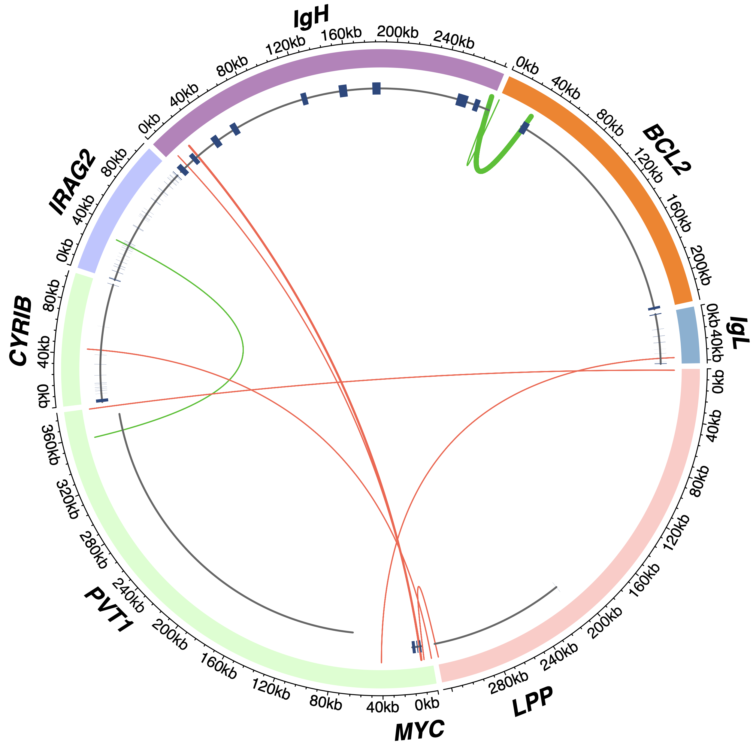



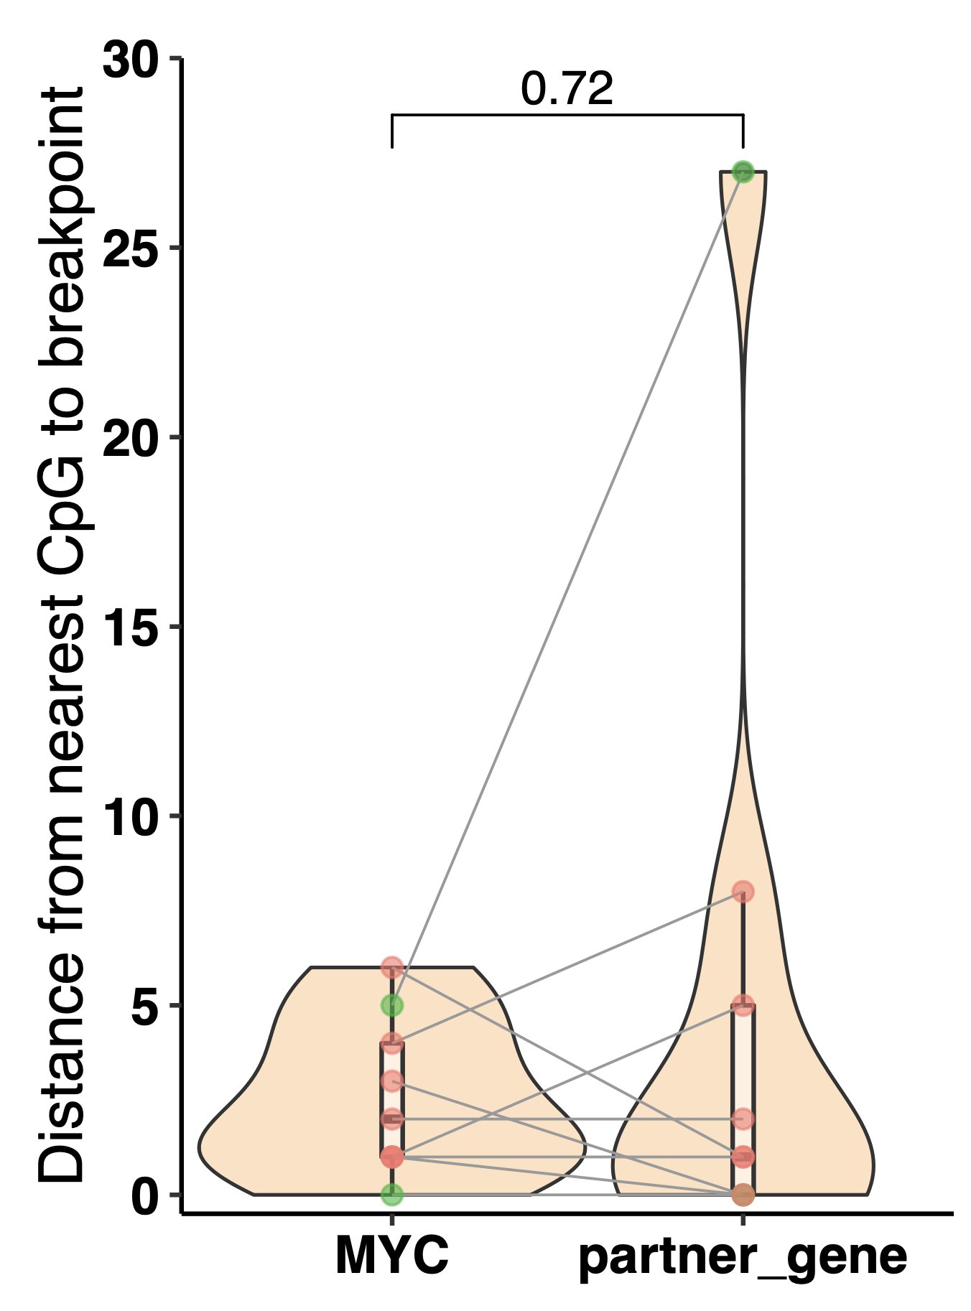
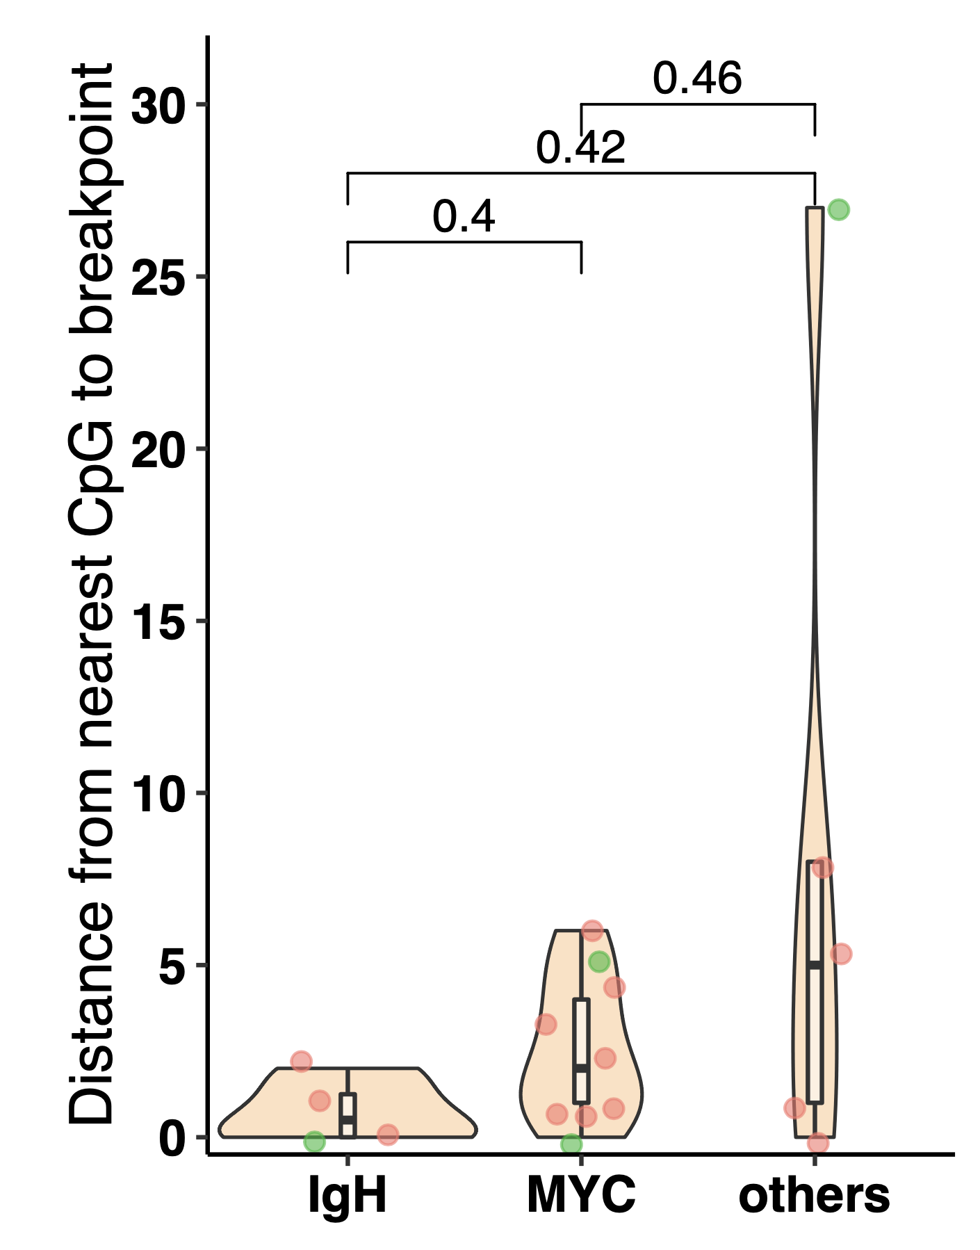
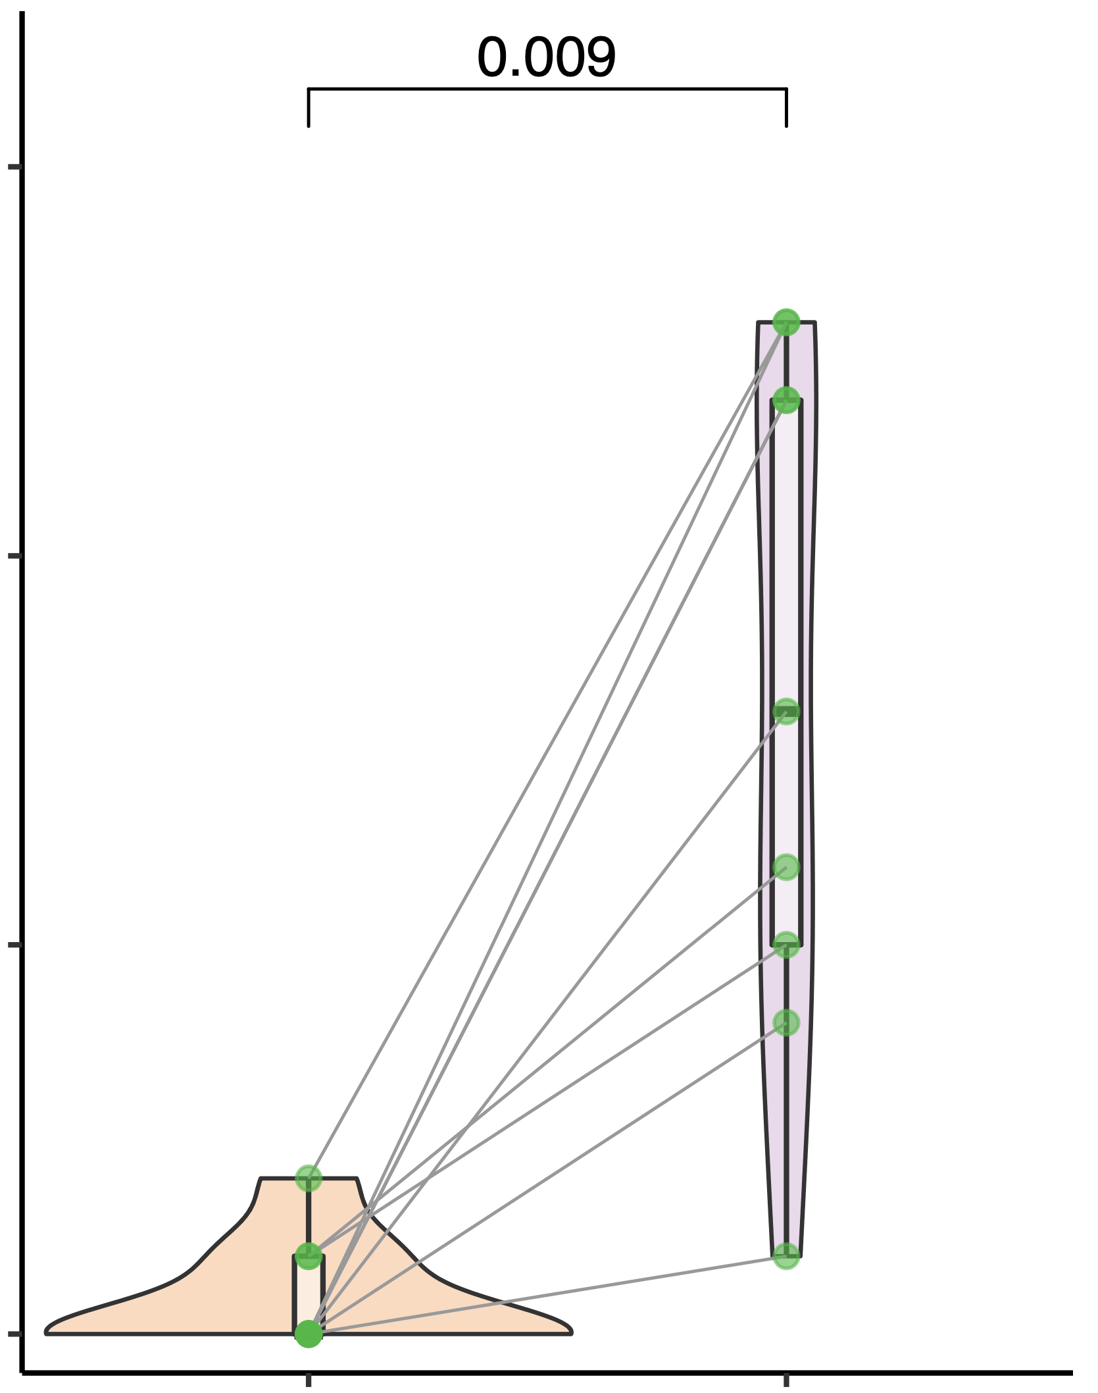
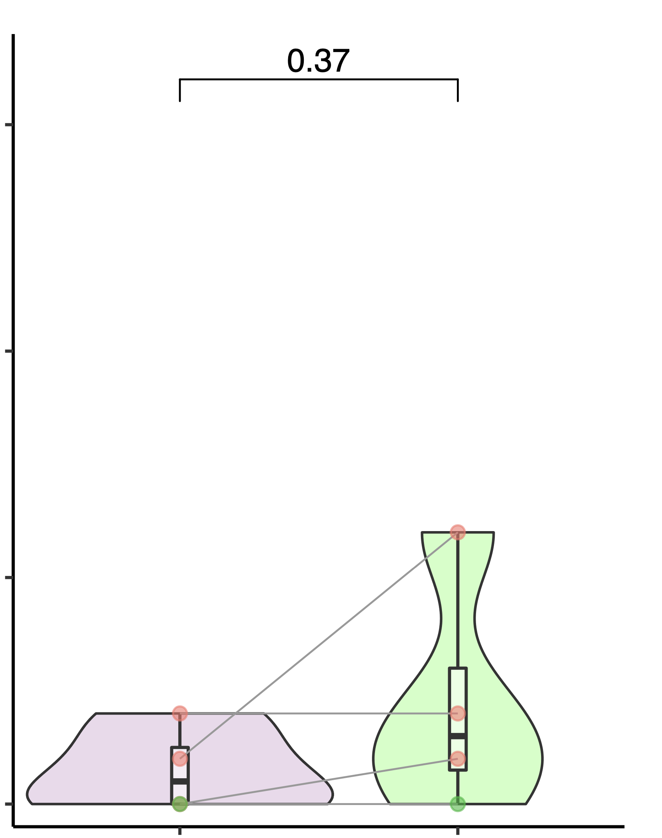
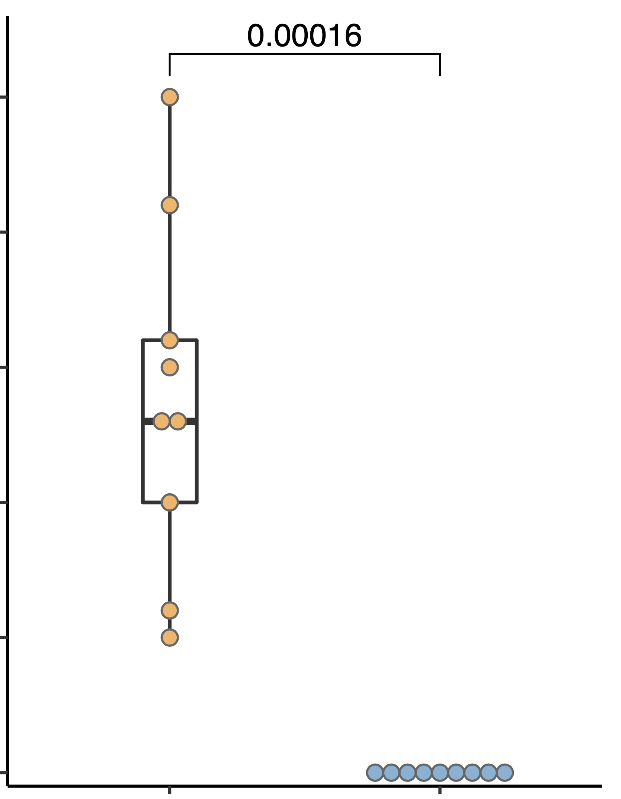
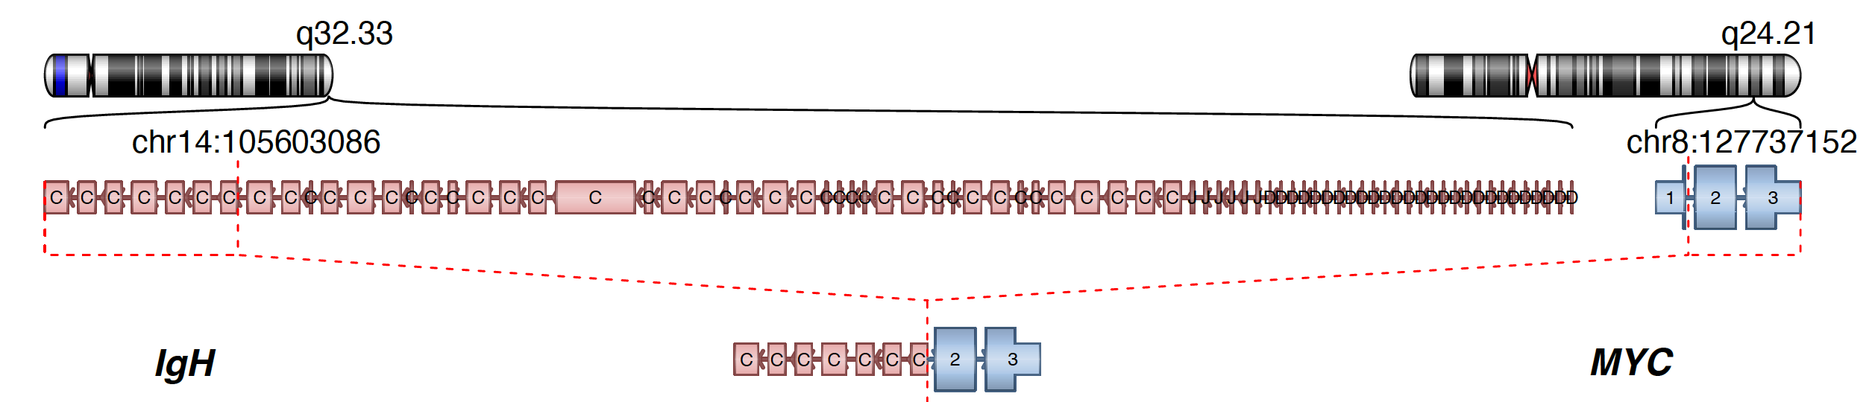
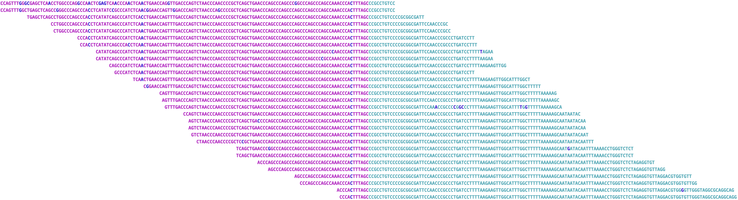
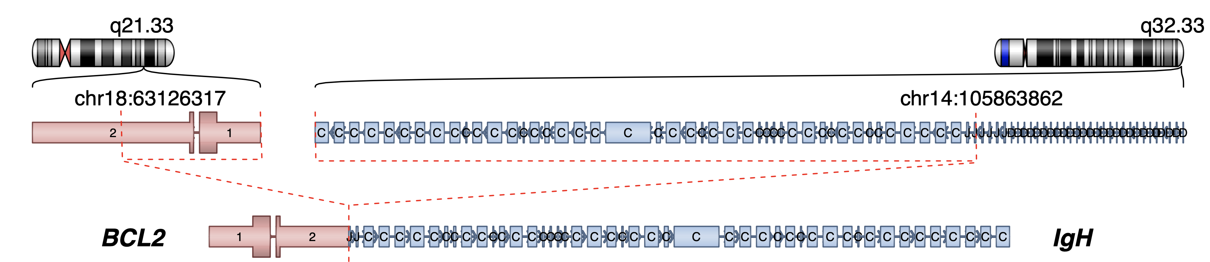
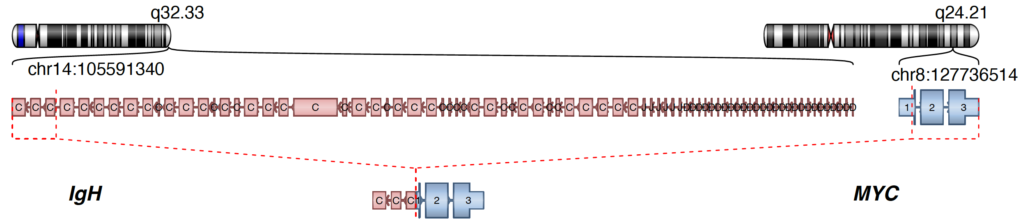
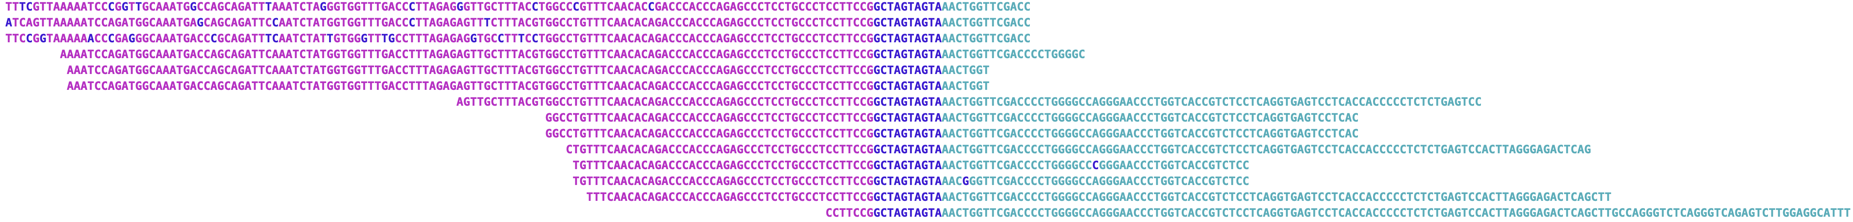
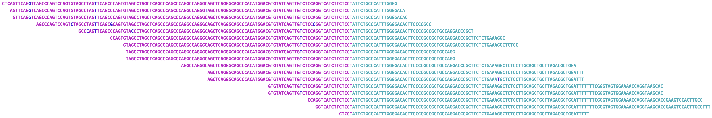
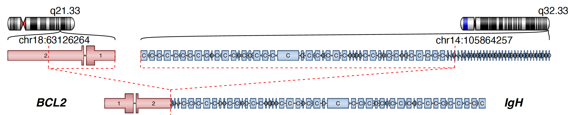
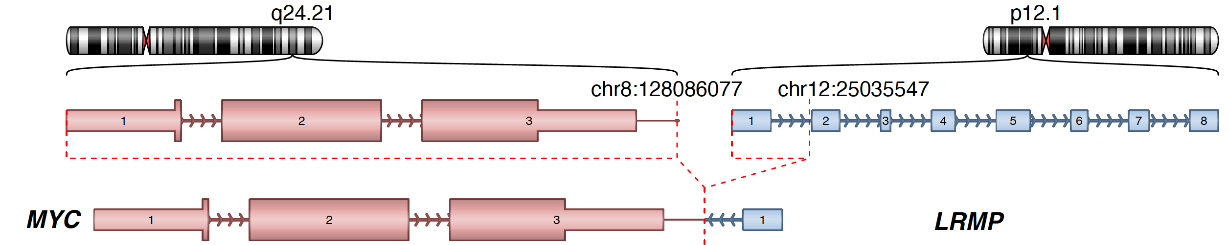
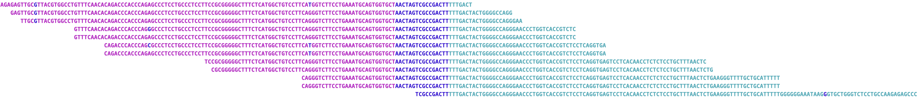
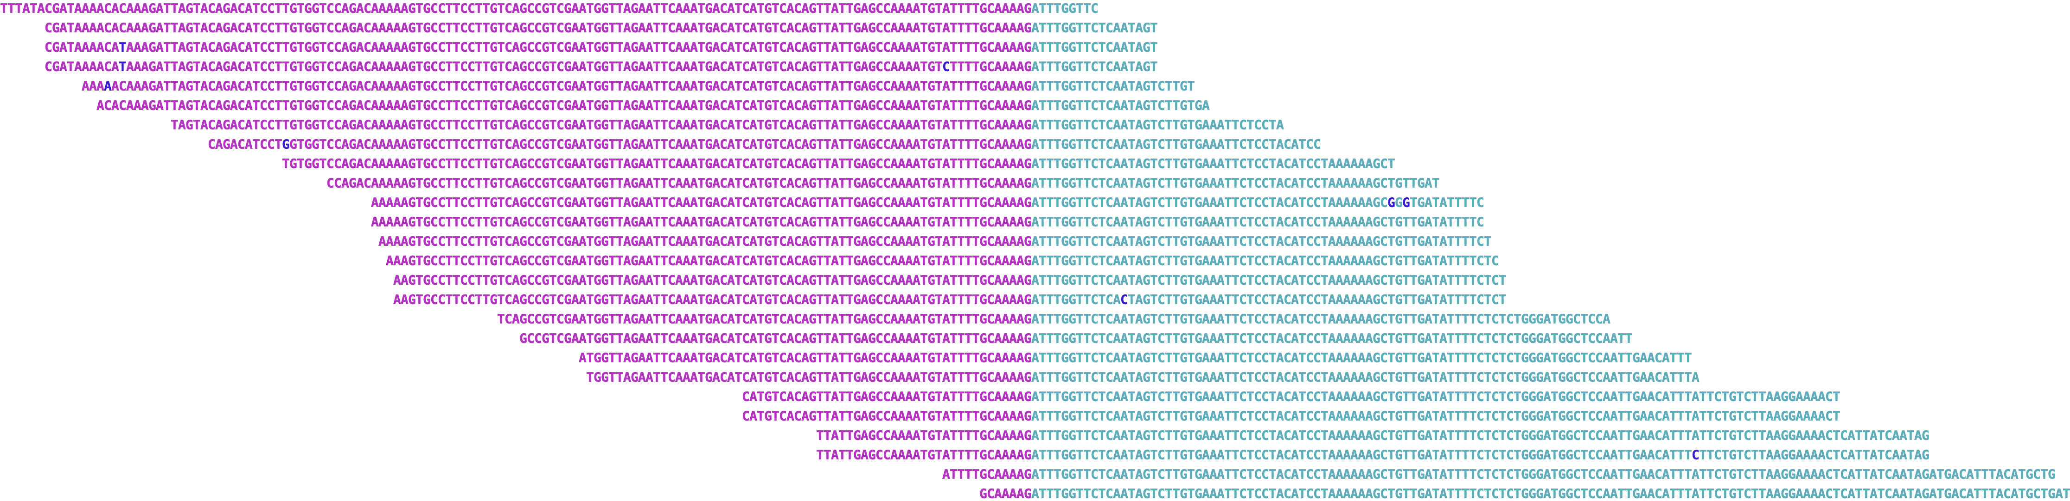
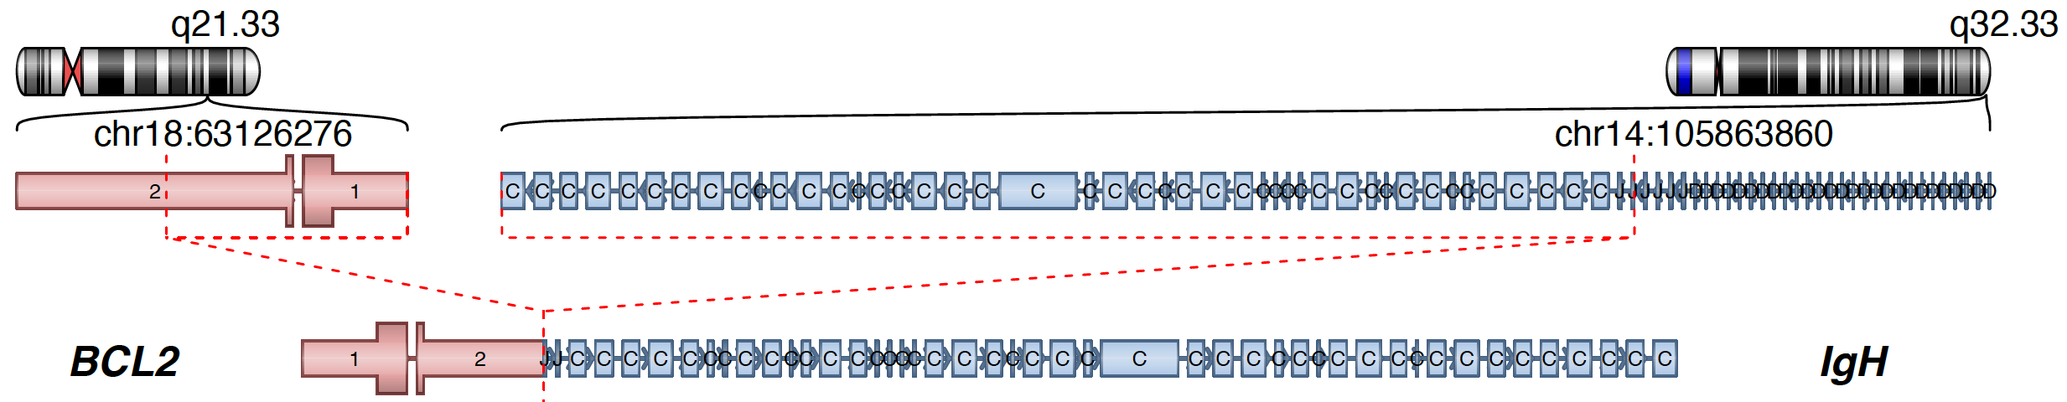
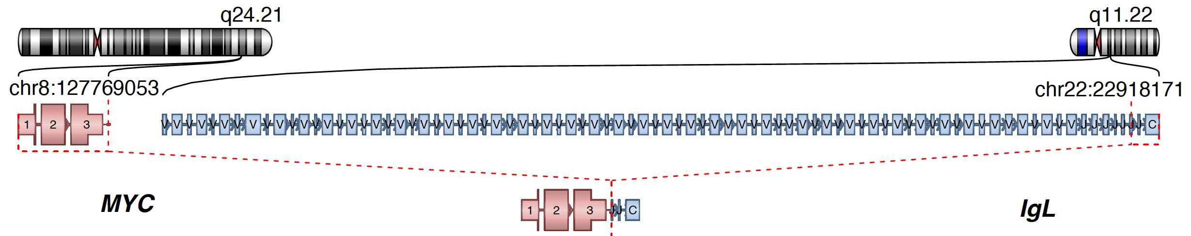

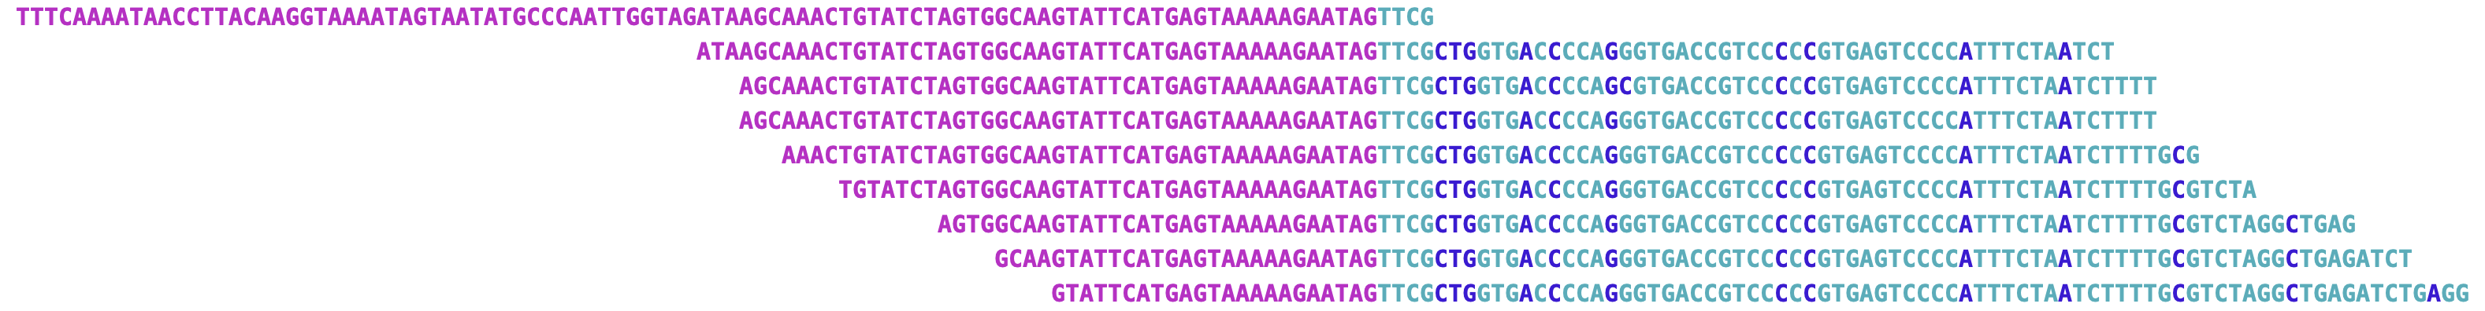
A
Both FL & DHL
B
AID type break
AID type break
DHL specific
chr18
BCL2
chr8
MYC
chr14
RAG type break
AID type break
IgH (J)
chr14
IgH S-region
15
p = 0.009
15
p = 0.37
10
10
Distance from nearest CpG site to breakpoint (bp)
Distance from nearest CpG site to breakpoint (bp)
5
5
0
BCL2
break point
IgH
break point
0
IgH
break point
MYC
break point
C
p = 0.00016
E
Non-homologous end-joining of BCL2 --- IgH
5’-CTTTGACTACTGGGGCCAGG-3’
25
+
5’-GTGGTGCTTACGCTCCACCA-3’
20
5’-GTGGTGCTTAAGATGGTGGGGCCAGG-3’
DNTT induced template-independent break-end insertion in pre-B phases.
15
Length of break−end insertions (bp)
Split reads extracted from P1.DHL tumor
Non-homologous end-joining of IgH --- MYC
10
5’-CGCGTCCCGCCCGCCTGTCC-3’
+
5’-CCACTTTAGCCTAGCTCAGC-3’
5
5’-CCACTTTAGCCCGCCTGTCC-3’
0
No break-end insertions in germinal center B stage.
BCL2
fusion
MYC
fusion
D
Split reads extracted from P1.FL tumor
Split reads extracted from P2.DHL tumor
break−end insertions
Split reads extracted from P2.DHL tumor
Split reads extracted from P4.DHL tumor
break−end insertions
Split reads extracted from P4.FL tumor
break−end insertions
Split reads extracted from P8.DHL tumor
Supplementary Figure 2. Breaking and joining of BCL2 and MYC rearrangement.
(a) BCL2 or MYC involved fusions in FL tumors and DHL tumors.
(b) Sequence pattern analysis of double strand breaks on BCL2/MYC fusion involved loci.
(c) Comparison of end-joining pattern between BCL2 fusion and MYC fusion. We observed template-independent break-end insertions exclusively enriched in BCL2 translocation but not MYC. The unique break-end joining mechanism in BCL2 might be triggered by activity of DNTT in pre-B stage, as DNTT is known for adding nucleotides at V-J gene junctions in pre-B and pre-T cells [Ref].
(d) BCL2-IgH translocation examples show template-independent break-end insertions in all junction supporting split reads.
(e) Junction reads of MYC fusions present no extra sequence inserted during the formation of translocation.
Reference
1. Lieber, Michael R. "Mechanisms of human lymphoid chromosomal translocations." Nature Reviews Cancer 16.6 (2016): 387-398.
2. Landau, NATHANIEL R., et al. "Increased frequency of N-region insertion in a murine pre-B-cell line infected with a terminal deoxynucleotidyl transferase retroviral expression vector." Molecular and cellular biology 7.9 (1987): 3237-3243.

